Slide 1
Music City Growth Analysis by Building Permits
Why are people moving to music city? Tiffany Conway

Slide 2

Change of Nashville
Skyline of 2015 verses skyline of 2024
Population continually increasing and with that must build homes to put the new residences
Headquarters in Nashville include Amazon, Oracle, HCA, Community Health Services, Sony, Vanderbilt, and many more

Slide 3
Permit Types
Commercial
Residential
CACA = Building Commercial Addition
CACF = Building Commercial Foundation
CACG =Building Commercial Structural Frame,
CACH= Building Commercial Shell
CACJ = Building Commercial Fire Damage
CACK =Building Commercial Roofing/Siding
CACL= Building Commercial Rehab Storm Damage
CACN=Building Commercial New
CACR=Building Commercial Rehab
CACS=Building Commercial New Storm Damage
CACT=Building Commercial Tenant Finish Out
CACP=Building Commercial Change of Contractor
CARA= Building Residential Addition
CARE= Building Residential Amend Permit
CARF=Building Residential Foundation
CARK=Building Residential Roofing/Siding
CARL= Building Residential Rehab Storm Damage
CARN=Building Residential New
CARR=Building Residential Rehab
CARS=Building Residential New Storm Damage
CART=Building Residential Tenant Finish Out
CARP=Building Residential Change of Contractor

Slide 4
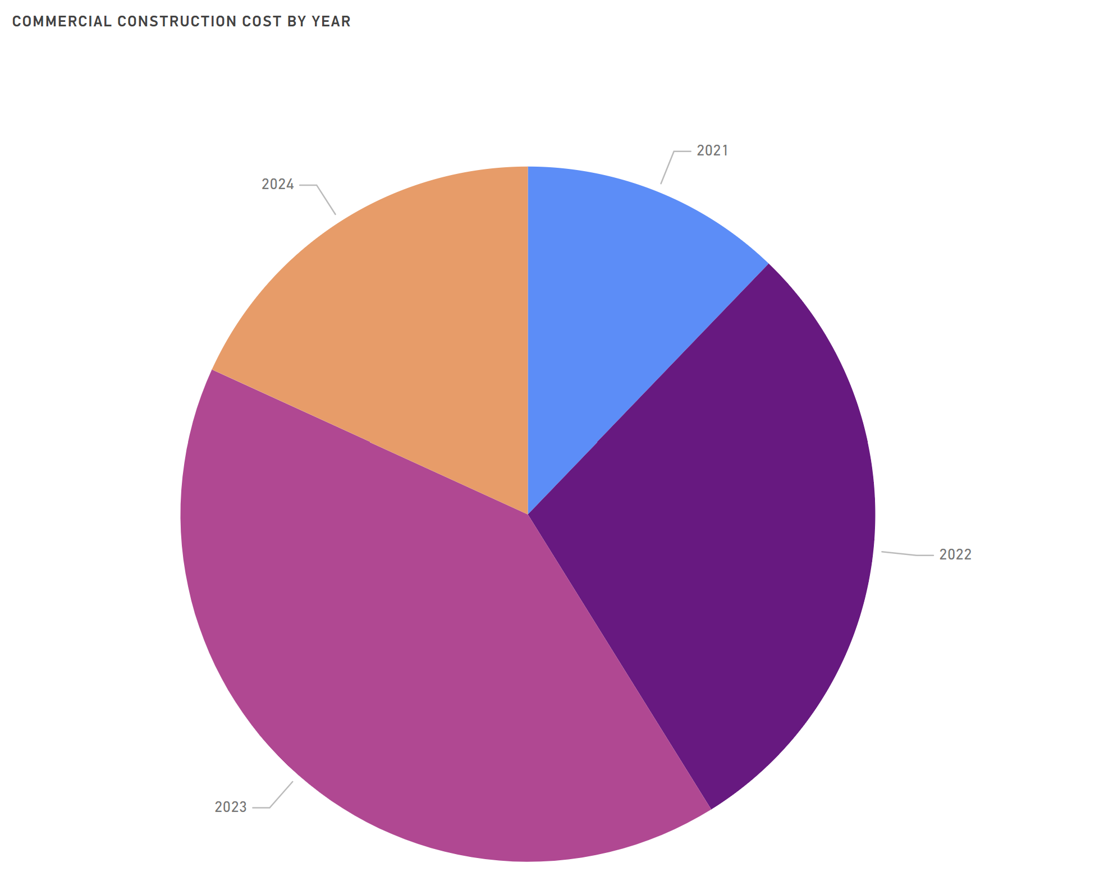
Construction costs
Commercial
Total Construction costs over all permits 916.97 million
2021 12.19%, $111,796,047
2022 28.96%, $265,535,304
2023 40.67% , $372,973,821
2024 18.18%, $166,664,089
Permits Power BI - Power BI

Slide 5
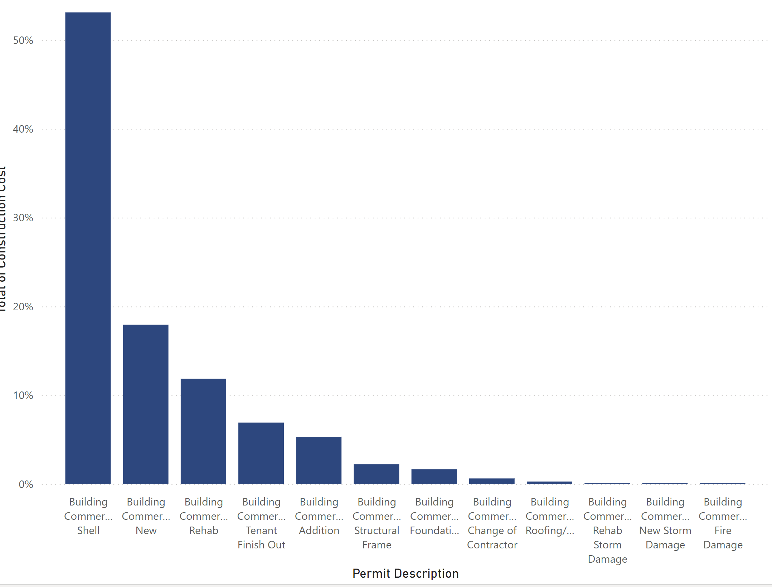
Commercial Permits
Building Commercial Shell is 53.10%
Building New makes up 17.94%
Building Addition make up 11.85%
Building Tenant Finish Out makes up 6.92%
Permits Power BI - Power BI

Slide 6
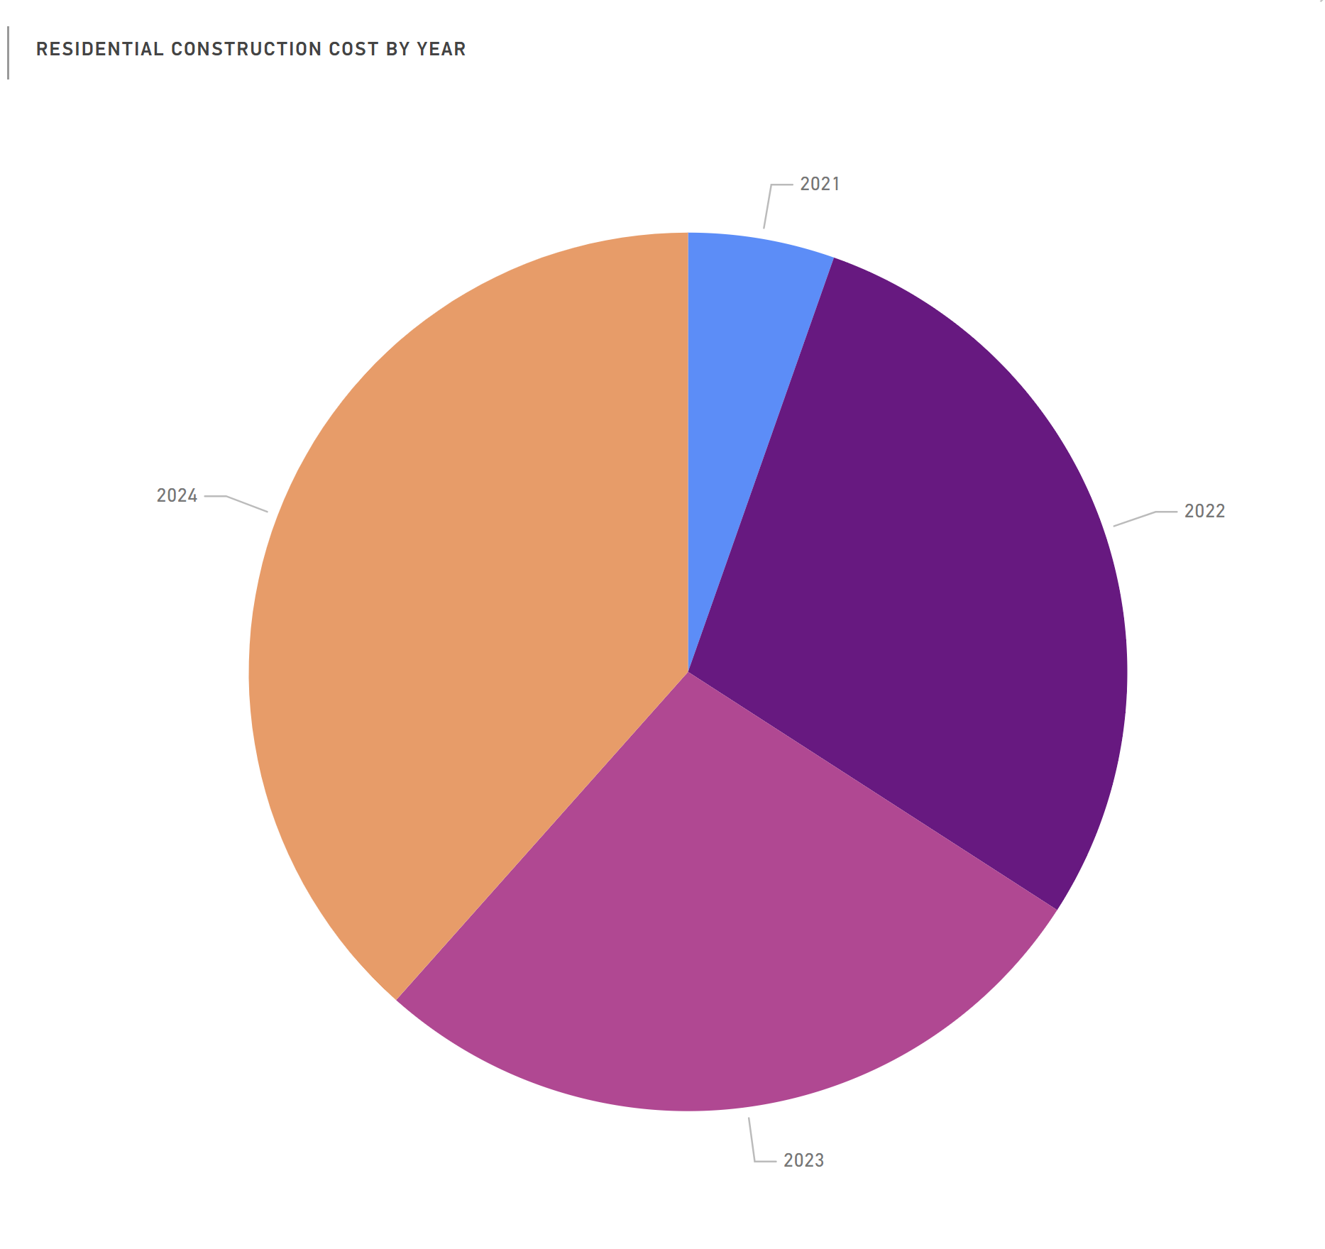
Construction costs
Residential construction costs
Total Construction costs over all permits 730.75 million
2021 5.39%, $39,375,896
2022 28.73%, $209,957,129
2023 27.45%, $200,593,327
2024 38.43%, $280,825,377
Permits Power BI - Power BI

Slide 7
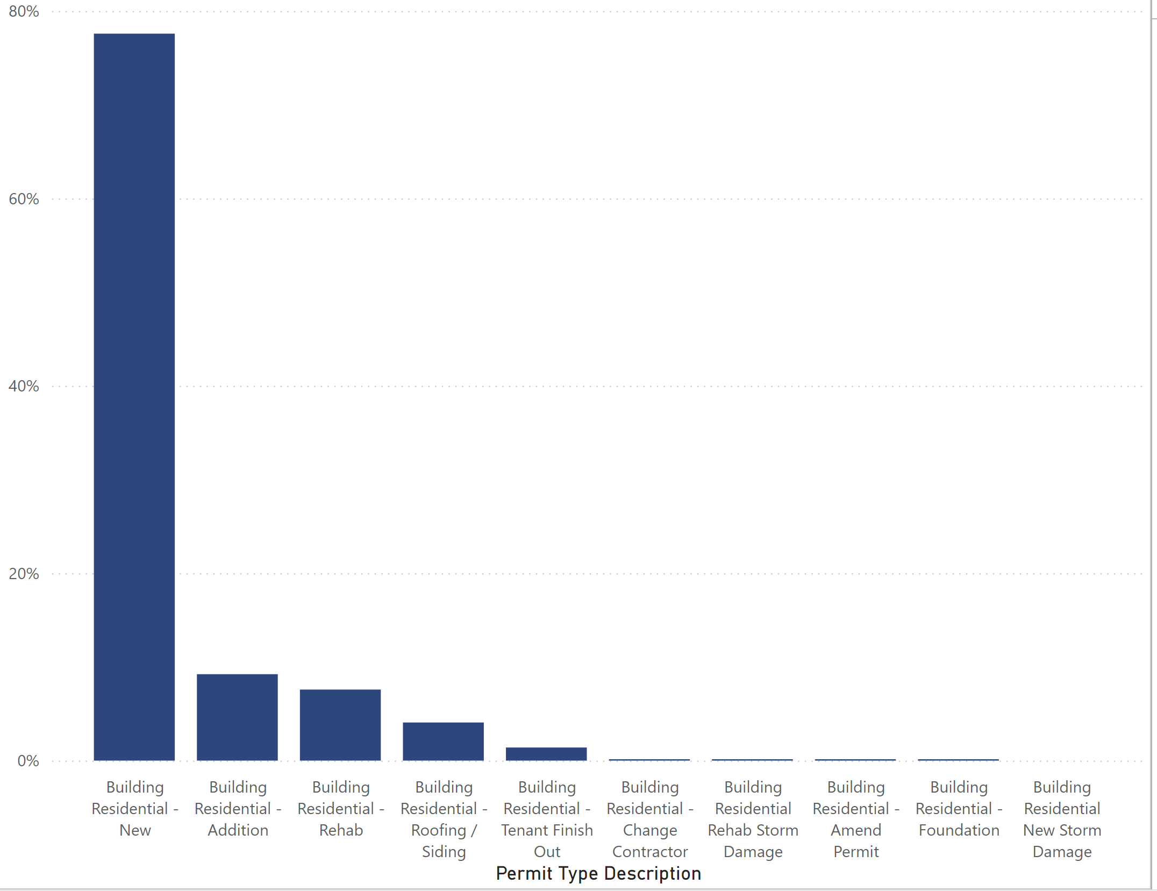
Building New Residential 77.59% of the building in the permit types
Permits Power BI - Power BI

Slide 8

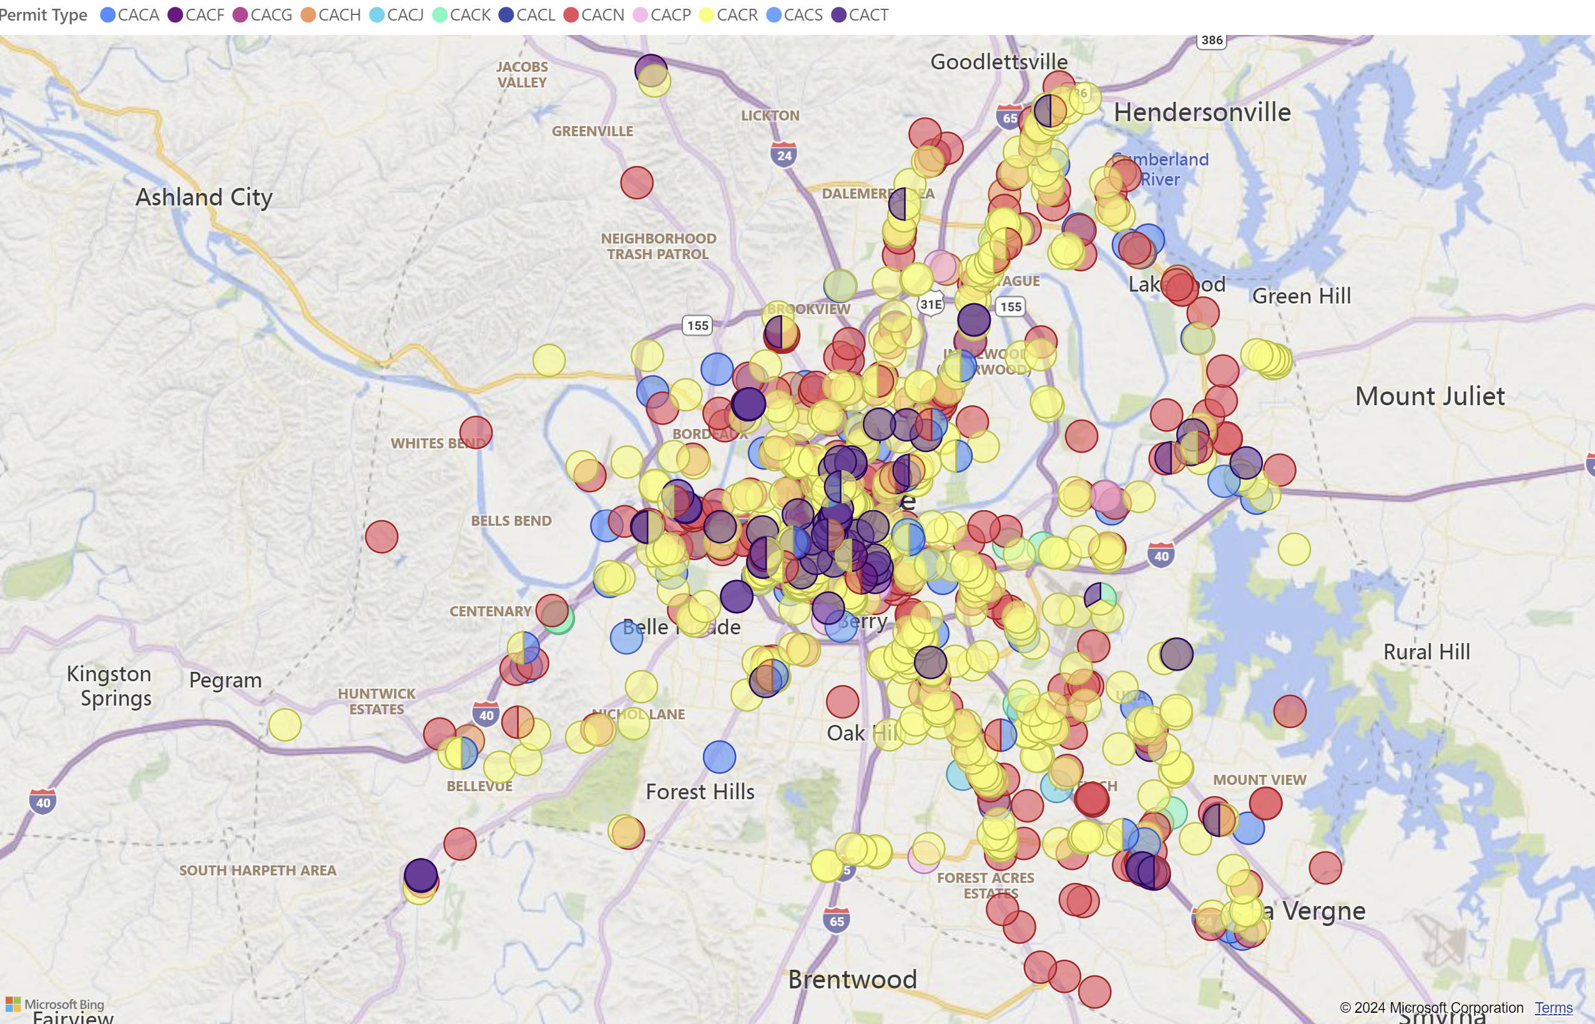
Commercial Permits pulled from 8/21 to 8/24 Permits Power BI - Power BI

Slide 9
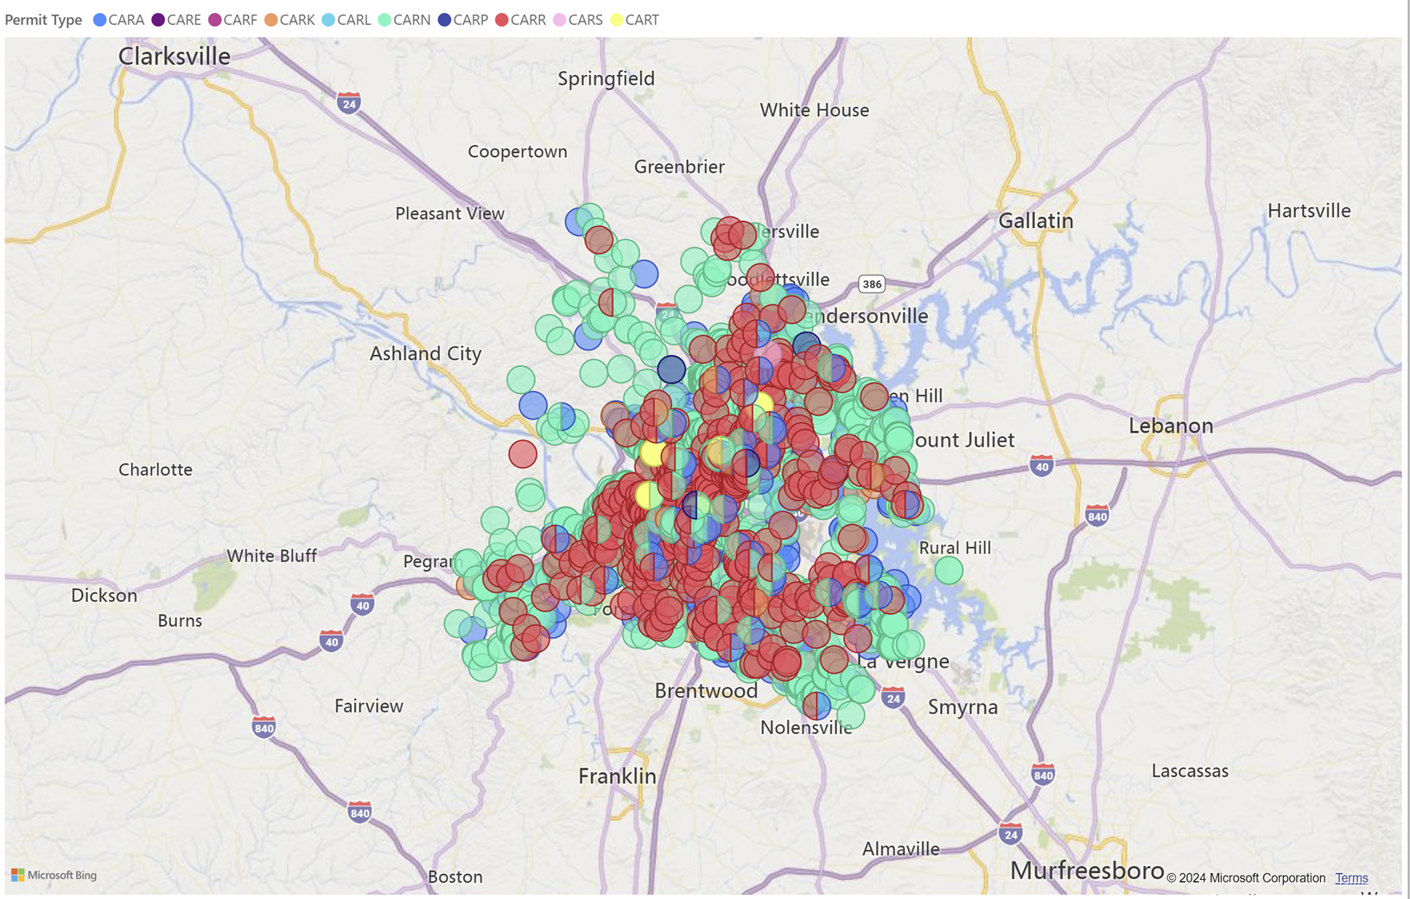
Residential Permits pulled 8/21 to 8/24 Permits Power BI - Power BI

